Slide 1
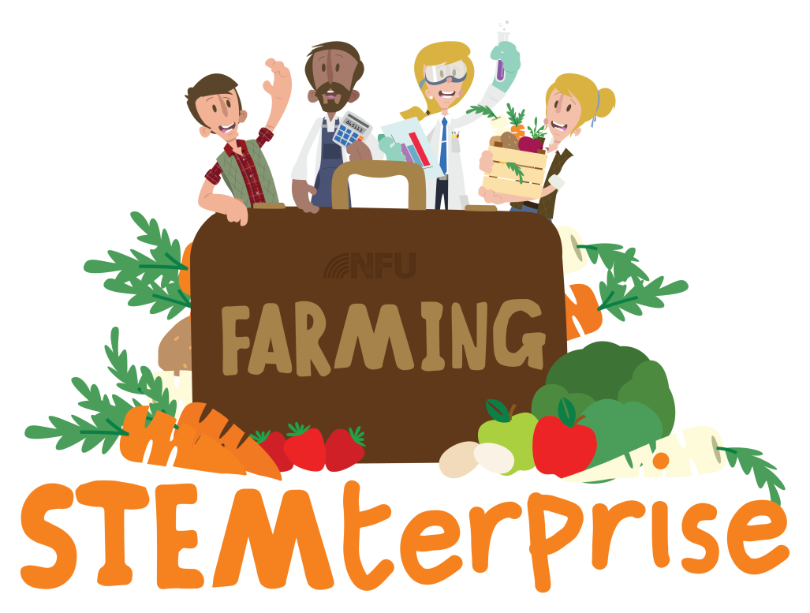
Stage 2: Plant Reproduction

Slide 2
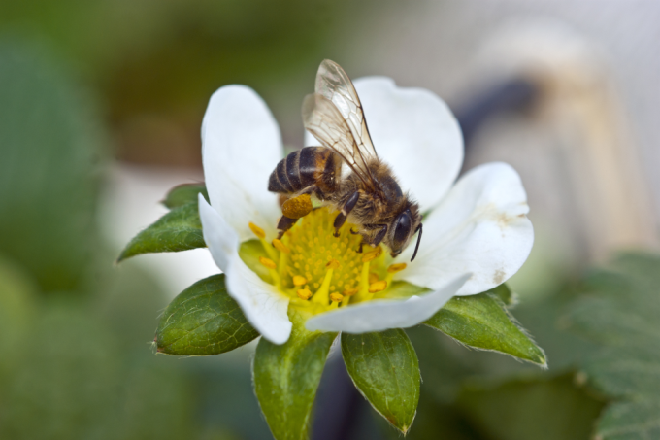
Learning Objectives:
To understand how flowering plants reproduce
To plot a line graph
We are going to be growing our own vegetables to use to make a lunchtime food product for our farm shop businesses but first, we will learn how plants reproduce (make more of themselves).

Slide 3
Warm up!
Let’s see what you can remember about plant reproduction from your Year 3 learning with a vertical relay!

Slide 4
Parts of the flower
Stamen
Stigma
Anther
Carpel
Filament
Style
Ovary
Petals
Ovules
Sepals

Slide 5
The Stamen
Stamen
Anther
Filament
The stamen is the male part of the flower. Each stamen consists of an anther held up on a filament. Pollen grains are produced by the stamens.

Slide 6
The Carpel
Stigma
Style
Ovary
The carpel is the female part of the flower. It consists of a stigma (the top of the carpel which collects pollen grains), the style and the ovary which produces the ovules.
Ovules

Slide 7
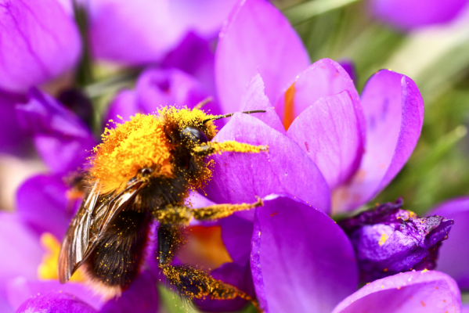
Reproduction in plants
Flowering plants reproduce (make more of themselves) by making seeds. Two processes must take place in the flower for seeds to be made: pollination and fertilisation.

Slide 8
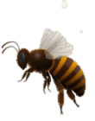
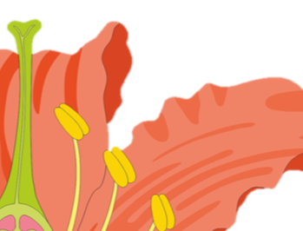
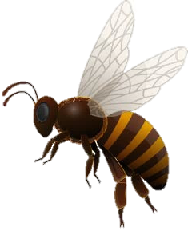
Pollination
Pollination takes place when the pollen from the male part of one flower (the stamen) travels to the female part of the same or another flower (the carpel). This can happen when pollinators, such as insects or birds, brush against the stamen of the first flower when they are drinking its nectar. Grains of pollen brush off the top of the stamen (the anther) and onto the pollinator.
Pollinator
Anther (top of the stamen)
Grains of pollen

Slide 9
Pollination
Then, when the pollinator travels to a different flower, the grains of pollen from the first plant fall off them and stick to the sticky top of second flower’s carpel (the stigma).
Stigma
Grains of pollen

Slide 10
Fertilisation
Once the pollen grain has stuck to the stigma of the second flower, a pollen tube grows through the style of the carpel until it reaches the ovary which contains ovules. Fertilisation takes place when the pollen grain joins together with an ovule in the ovary.
The fertilised ovule will then become a seed.
Pollen grain
Style
Ovary
Pollen tube
Ovules

Slide 11
Activity 1: Practical exploration
Carefully dissect your flower and examine each part using a magnifier.
Arrange each dissected part separately on your large strip of paper and label them to make a poster for the working wall.
While you are working, discuss the parts you are labelling and how they are involved in pollination and fertilisation.

Slide 12
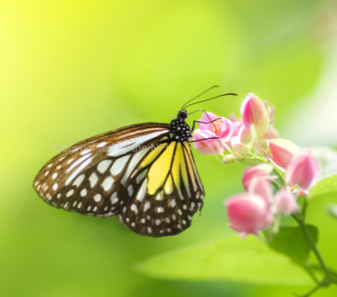
Activity 2: Application of learning
Use your learning to write an explanation of the processes of pollination and fertilisation in plants.
We will then use this as a script to make a stop-motion animation movie all about where seeds come from.

Slide 13
Vertical relay round 2!
Let’s see what you have learnt about plant reproduction today with another vertical relay!

